Slide 1




HackOrbit 2025
CODE MARVELS

Slide 2

THEME & PROBLEM STATEMENT
Deep conceptual clarity, regular self-evaluation, and efficient time management are all necessary for the demanding process of preparing for competitive exams like UPSC, JEE, and NEET. Nevertheless, many candidates do not have access to adaptive learning materials, real-time feedback, or individualized counseling. The one-size-fits-all methodology of traditional coaching models frequently ignores each person's unique learning preferences, strengths, and shortcomings. An intelligent, data-driven tutoring system that can offer personalized study plans, dynamic test creation, and ongoing performance analysis is desperately needed. This will enable students to learn more effectively rather than more difficultly.

Slide 3
PROPOSED SOLUTION
Introducting ExaMind - Your Personalized AI Mentor for Exam Success.
ExaMind is an intelligent tutor driven by artificial intelligence that challenges the conventional methods used by students to get ready for competitive tests like UPSC, JEE, NEET, and others. As a personal tutor, ExaMind creates a customized study schedule based on the learner's time constraints and areas of strength and weakness. It then uses adaptive mock exams that change in real time according to the learner's performance. Through a thorough data analytics dashboard, ExaMind offers topic-specific insights and performance feedback. ExaMind uses natural language processing (NLP) to analyze past year's questions and present high-weighted topics. It also has an AI chatbot that can answer questions and provide concept explanations in real time. ExaMind uses spaced repetition to strengthen weak areas and continuously monitors progress to reassess learning strategies in order to encourage intelligent, efficient, and successful exam preparation practices. ExaMind is a learner's biography that offers a customized, dynamic intelligence exam companion.

Slide 4
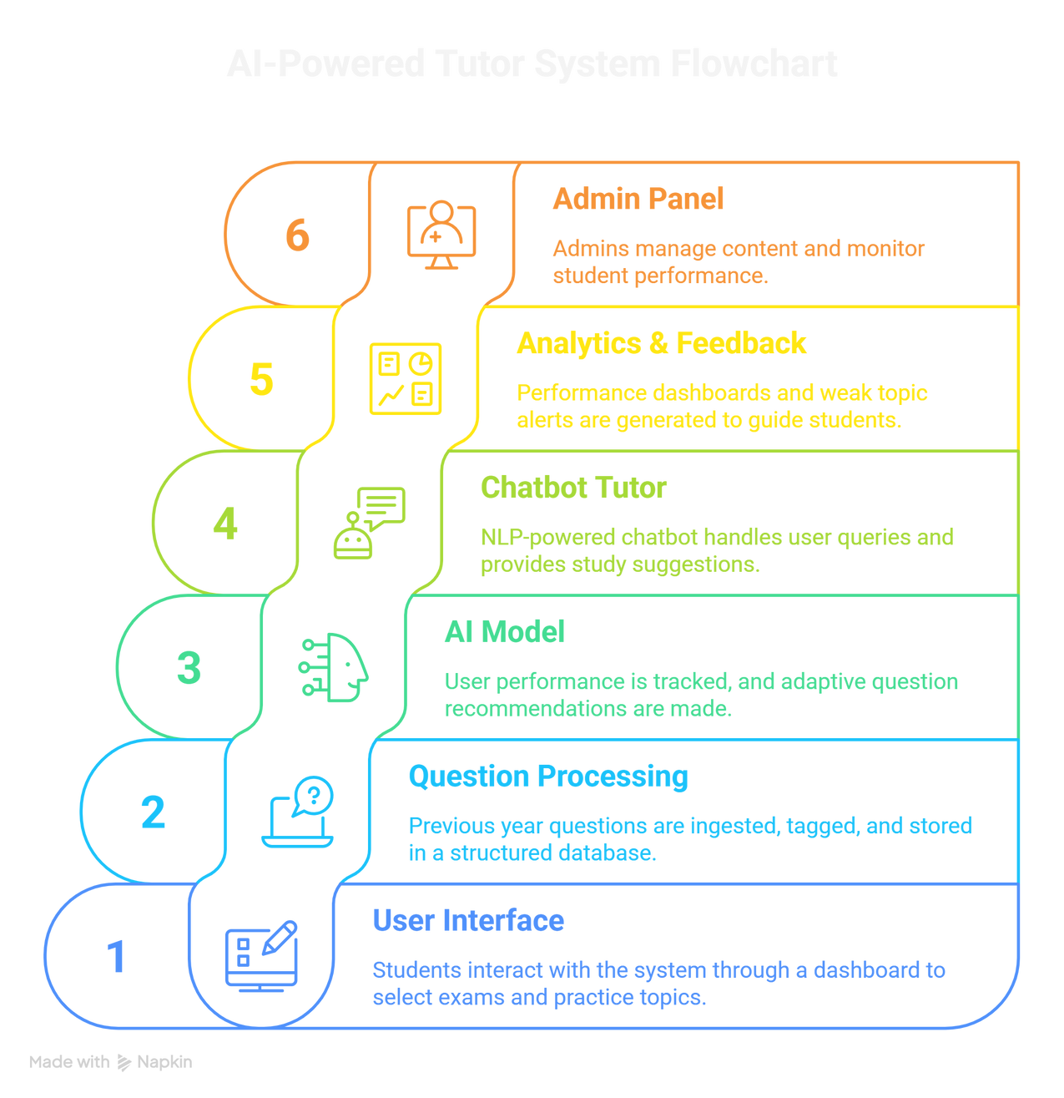
FLOWCHART

Slide 5
FLOWCHART
1. The User Interface
The groundwork for individualized learning is laid by students logging in and choosing their target exam, preferred method of learning, and available time.
2. Processing of Questions
The system highlights high-weighted topics, suggests crucial questions, and analyzes PYQs (both exam-wise and topic-wise).
3. AI Model
The AI model creates a personalized study schedule with suggested questions based on performance metrics (accuracy, speed, and consistency).
4. Chatbot Instructor
An NLP-based chatbot offers instant answers to students' questions as well as explanations and suggestions for concepts.
5. Analytics & Feedback
Performance dashboards, weak topic highlights, and revision alerts are all produced by mock exams and quizzes.
6. Admin Panel
Admins manage content, monitor student performance, and ensure quality control across the platform.

Slide 6
FEATURES
NOVELTY
1. Individualized Education
AI generates a personalized study schedule based on: Exam type (UPSC, JEE, NEET, etc.), The student's availability, pace, and areas of weakness.
Plans are dynamically updated in response to performance.
2. Flexible Mock Test Creator
Test creation by topic, section, and length.
Based on student responses, difficulty changes in real time.
3. Dashboard for Performance Analytics
Visual progress monitoring using heatmaps, graphs, and charts.
Reports on accuracy, speed, and consistency
4. PYQ analysis Engine
Analysis of PYQ Previous Year Questions (PYQs) categorized by the engine. Each question is tagged according to its frequency and difficulty
5. AI Chatbot for Clearing Up Doubts
Comprehends questions in natural language (voice or text). Provides clarifications, examples, and answers to conceptual questions.
6. Smart Feedback & Recommendations
Feedback in real time following each test or subject. Makes specific practice recommendations based on areas of weakness.
1. Adaptive Learning Driven by AI
Learning plans, test difficulty, and revision techniques can be changed in real time based on performance, something that traditional apps do not offer.
2.Aware of Context Chatbot Instructor
In order to provide customized explanations rather than generic answers, the chatbot takes into account the student's level, the scope of the syllabus, and previous mistakes
3.In-Depth PYQ Integration
A distinct advantage for competitive exams is the use of machine learning (ML) to identify patterns in years worth of prior papers and direct attention toward high-weightage subjects.
4. Flexibility in Multiple Exams
This tool supports multiple exams (JEE, NEET, UPSC, etc.) with a modular configuration, in contrast to single-exam platforms.
5. The Learning Loop Supported by Data
It continuously improves suggestions using real learning behavior (such as test patterns and time spent on each topic)—a closed feedback loop.

Slide 7
DRAWBACK
SHOWSTOPPERS
Restricted Access to Datasets
The quality of training may be impacted by incomplete, unstructured, or unlabeled previous year question papers (PYQs) that are made publicly available for certain exams.
Reliance on Cloud APIs
For chatbot or NLP tasks, relying on external APIs like OpenAI could result in latency, outages, or expensive costs over time
Absence of Human Empathy
Because the AI tutor lacks emotional intelligence, it is unable to inspire or relate to students in the same way that a human mentor can
Moodel Inaccuracy for Edge Cases
AI-based responses, particularly those provided by chatbots, can occasionally be inaccurate or deceptive, especially when they pertain to open-ended or subjective questions.
Limitations of Generalization
It is necessary to fine-tune the model for each exam because different exam formats may require different models (e.g., multiple-choice versus essay-based).
Absence of Labeled Data of High Quality
The adaptive engine and smart test generator might not function correctly if the questions are not properly tagged by topic and difficulty.
Feedback that is inaccurate or damaging
The student's confidence and readiness may suffer if the AI provides incorrect test recommendations or explanations
Risks to Data Security and Privacy
trong encryption and adherence to data protection regulations, such as the GDPR, are necessary when storing sensitive student data, such as test results and performance.
Bottlenecks in Scalability
If infrastructure is not appropriately optimized, real-time adaptive testing and chatbot responsiveness may deteriorate as user volume rises.
Expensive Model Inference
Large NLP models (such as BERT/GPT) may be computationally demanding and unprofitable for free-tier platforms to run in real-time for each user query.

Slide 8
CODE MARVELS
Anika Singh
(anika.rbs@gmail.com, +91-9872131723)
Arjun Chauhan
(chauhanarjun177@gmail.com, +91-9467751363)
Inderpreet Kaur
(inderpreetkaurr08@gmail.com, +91-9465296851)
Chitrabhanu Srivastava
(bhannuu2031@gmail.com, +91-9478221898)

Slide 9
Thank you

